Slide 1
Stari Grad Plain

Slide 2
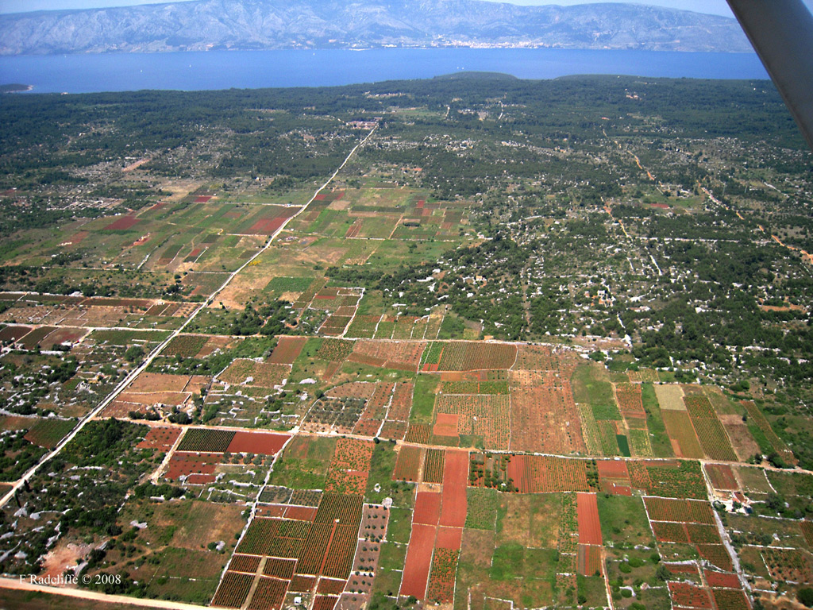
Have you ever heard about that?
It is land organisation system based on geometrical parcels with dry stone walls

Slide 3
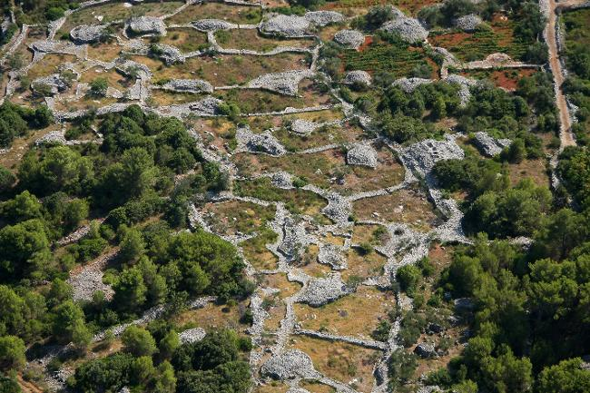
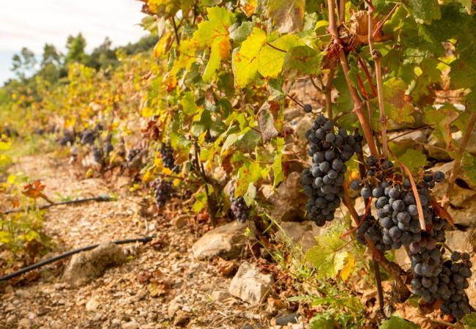
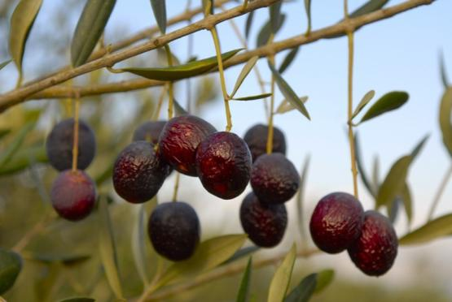
How it works?
The Greek system has been respected till today
There is also water collection system
There are still grown grapes and olives

Slide 4
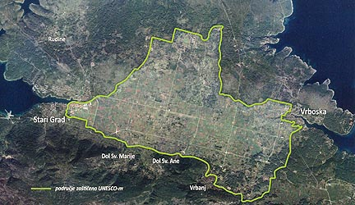
Where is located?
It is located on island Hvar near Stari Grad

Slide 5
Is it protected?
The Stari Grad Plain is Croatia's 7th location protected by UNESCO

Slide 6
THE END

